Slide 1

V 1.0.2

Slide 2


Slide 3
1.3B income in 2021
3500M dowload in total

Slide 4


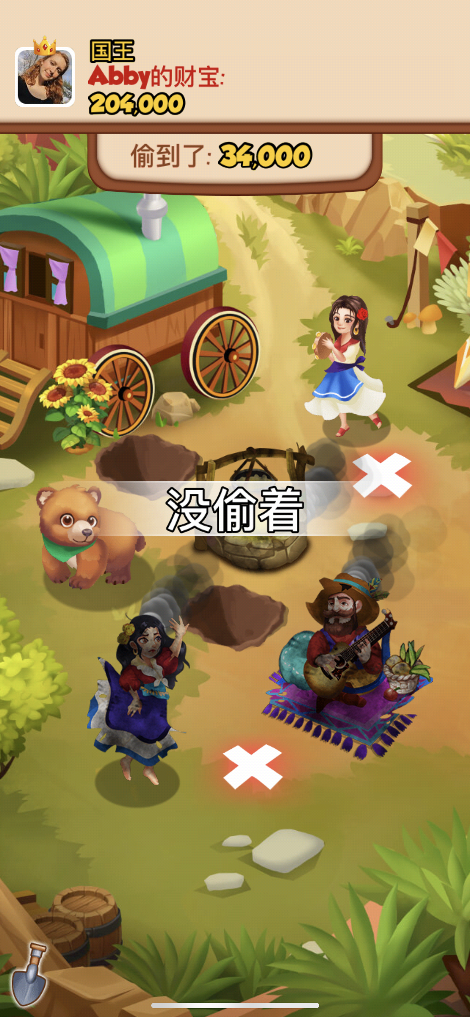



消耗体力轮转老虎机出金币，攻击，盾牌，偷盗
老虎机轮转出攻击
攻击成功获得金币
老虎机轮转出偷盗
偷盗失败，没有挖出金币
菜单栏

Slide 5
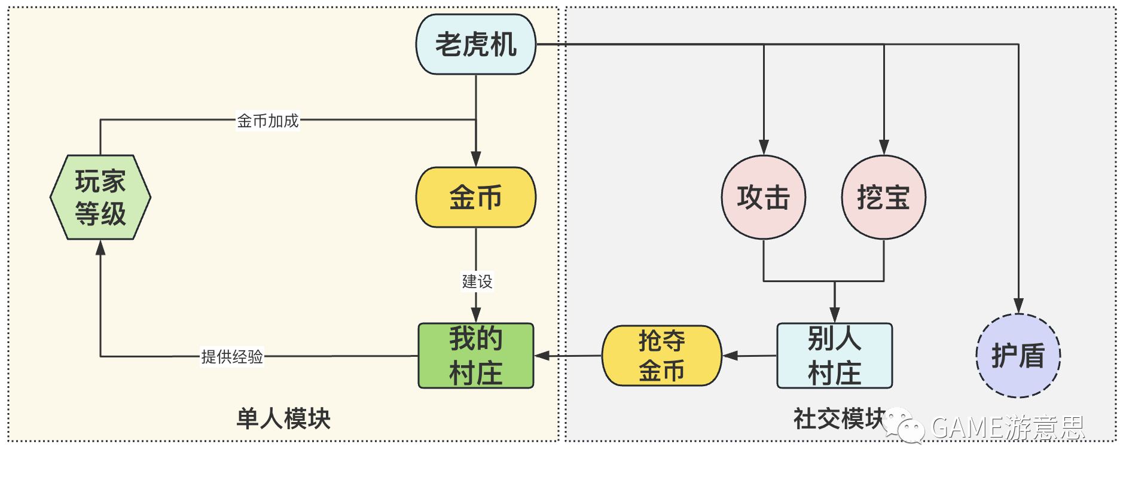

Slide 6


Slide 7

asynchronous social

Slide 8
thanks

